Slide 1
Exam 220-1202
A+ Core 2

Slide 2
Managing Support Procedures
A+ 220-1202
Module 11

Slide 3
Learning Outcomes
Prepare for A+ Core 2 by:
Understanding industry best practices in support documentation
Understanding and using professional communication
Identifying various operating systems and their uses

Slide 4
Documentation
Lesson 11.1
Notes:
Core 2 Exam Objectives
4.1 Given a scenario, implement best practices associated with documentation and support systems information management.
4.6 Explain the importance of prohibited content/activity and privacy, licensing, and policy concepts.(Acceptable Use Policy)
Learning Outcomes
What is an SOP and how is it different from a policy?
How do ticketing systems assist in documentation of issues?
How are support tickets prioritized?
What are the characteristics of good documentation?

Slide 5
Standard Operating Procedure
SOP
Defined as step-by-step instructions for any task
Use guidelines when there are many variables or complex decision-making processes involved
Notes:
Consider showing the video 11.5.2 Documentation Policies and Procedures in the additional resources for this module.

Slide 6
Service Level Agreements
Defines the metrics of service delivery
Internal agreements between departments
External agreements with third-party providers like an ISP or CSP
Rule of Nines
5 nines(99.999%) 5.26 mins of downtime per year
8 nines(99.999999%) 315.58 milliseconds downtime per year
Notes:
Learners should understand the rule of nines is used for downtime calculations but also for data loss calculations for disasters and incidents.

Slide 7
Incident and Ticketing Systems (Slide 1 of 2)
Used to manage requests, incidents, and problems
Can be used to assign issues to technicians and track updates of the resolution process
Notes:
Remind learners to expect the organization they work for to have a ticketing system in place.

Slide 8
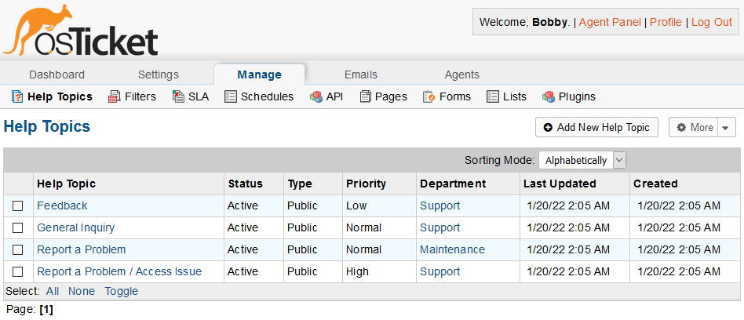
Incident and Ticketing Systems (Slide 2 of 2)
Screenshot courtesy of osTicket.com.
Notes:
Defining help-desk categories in the osTicket ticketing system. Remind learners that the layout and appearance of different interfaces can vary.

Slide 9
Categories and Severity
Categories unique to each organization
Requests
Provision assets like new accounts or systems
Incidents
Errors or unexpected conditions
Problems
Incidents that require reconfiguring the system or network
Prioritize issues by severity
Critical
Major
Minor
Notes:
Remind learners that while each organization chooses how to categorize and prioritize issues, it is a general best practice to list them in writing. Qualitative and quantitative analysis processes aid in the decision-making process. NIST provides frameworks and best practices for management of cybersecurity incidents.

Slide 10
Ticket Management
Ticket
Communicates updates to technicians and clients/customers
Escalation
An issue is beyond the scope of the technician/agent
Internal escalation to another technician or department
External escalation to third-party provider or manufacturer support
Tier 0- self service
Tier 1- initial agent for diagnosis
Tier 2- senior technicians
Tier 3- engineering team or senior management
Notes:
Have learners try the Escalation Levels interactive activity individually or in groups.

Slide 11
Support Documentation and Knowledge Base Articles
Documents relevant information for the issue or incident resolution
Provides information for future issues
Provides technicians with initial diagnosis checks
Provides troubleshooting steps that worked in the past

Slide 12
Lessons Learned
After-action reports
In-depth analysis of an issue or incident that drives changes to policy or procedures
Can evolve into new SOPs

Slide 13
Clear Written Communication
Include issue description
Include progress notes
Include problem resolution
Keep notes clear and concise
Notes:
Provide a quick update but include enough detail to ensure the resolution process is well-documented. This can assist in the development of SOPs and FAQs in the future.

Slide 14
Knowledge Base
A self-serve central repository for information related to service issues
Can include checklists for troubleshooting
OEM or application developers may provide information
Notes:
Consider showing learners the video Knowledge Base Articles to reinforce these concepts.

Slide 15
Policy Documentation
Acceptable Use Policy (AUP)
A list of acceptable behaviors and practices while utilizing corporate networks and systems
Splash screen reminders to reinforce compliance

Slide 16
Lab: Create a Ticket (available in CertMaster Learn and CertMaster Perform)
Lab: Close a Ticket (available in CertMaster Learn and CertMaster Perform)
Lab: Use Help Desk System (available in CertMaster Learn and CertMaster Perform)
Live Lab: Explore the VM Lab Environment (available in CertMaster Perform and CertMaster Labs)

Slide 17
Documentation
Standard Operating Procedure
Service Level Agreements
Incident and Ticketing Systems
Categories and Severity
Ticket Management
Support Documentation and Knowledge Base Articles
Lessons Learned
Clear Written Communication
Knowledge Base
Policy Documentation
Notes:
Take some time at the end of each topic to answer questions. You can use the Lesson Review questions for discussion in class or set them for learners to complete individually during or after class.

Slide 18
Professional Communication
Lesson 11.2
Notes:
Core 2 Exam Objectives
4.7 Given a scenario, use proper communication techniques and professionalism.
Learning Outcomes
What are the characteristics of professional communication?
How does maintaining a positive attitude affect a service call?
How should you deal with a difficult situation such as an angry client or customer?

Slide 19
Professional Support Processes
Document service hours and procedures to open a ticket
Set and meet expectations and timelines
Consider repair and replacement options
Follow up to ensure solution works
Notes:
Consider showing learners the video Importance of Effective Communication to reinforce professional support processes concepts.

Slide 20
Professional Support Delivery
Arrive on time
Avoid distractions
Personal phone calls, text messages, or social media
Handle confidential and private material appropriately
Do not access material or data on a system without permission

Slide 21

Professional Appearance
Professional appearance and attire
Use proper language
Avoid jargon
Use cultural sensitivity
Customs and habits of cultures vary
Image by goodluz © 123RF.com.

Slide 22

Professional Communications
Active listening
Maintain eye contact
Avoid interrupting
Repeat back your understanding
Image by goodluz © 123RF.com.
Notes:
Listening carefully will help you to get the most information from what a customer tells you. Look for clues to the customer's technical level of understanding.

Slide 23
Clarifying and Questioning Techniques
Open-ended questions draw out further information
Start with these questions
Closed-ended questions result in simple answers like yes or no
Use these to confirm the suspected issue
Notes:
Instructors may ask learners to provide examples of each type of question.

Slide 24
Difficult Situations
Maintain a positive attitude
Avoid
Arguing with the customer
Denying or dismissing the problem
Being judgmental

Slide 25

Dealing with Difficult Customers
Identify when a customer is getting angry
Do not take complaints personally
Actively listen to complaints
Hang up if a customer becomes abusive or threatening
Seek assistance from a supervisor or other technicians
Image by Wang Tom © 123RF.com.
Notes:
Instructors should convey to learners that they should remain positive when supporting customers. For the customer, their day is not going well due to the issue, and they may be upset or even angry. Remain calm and positive, but do not accept abuse or threats from the customer.

Slide 26
Do Not Post Experiences on Social Media
Venting in public opens the door for scrutiny
Follow company policy when discussing issues and cases

Slide 27
Professional Communication
Professional Support Processes
Professional Support Delivery
Professional Appearance
Professional Communications
Clarifying and Questioning Techniques
Difficult Situations
Dealing with Difficult Customers
Do Not Post Experiences on Social Media
Notes:
Take some time at the end of each topic to answer questions. You can use the Lesson Review questions for discussion in class or assign them for learners to complete individually during or after class.

Slide 28
Types of Operating Systems
Lesson 11.3
Notes:
Core 2 Exam Objectives
1.1 Explain common operating system (OS) types and their purposes
Learning Outcomes
What are the four main operating systems found on computer systems?
What are the two most common mobile operating systems?
What file systems are commonly used by each operating system?
What happens when a system reaches end-of-life?

Slide 29
Windows and macOS (Slide 1 of 2)
Windows
Windows 10 and 11
Server 2019, 2022, and 2025 are optimized for enterprise environment management
macOS offers a desktop OS exclusive to Apple hardware

Slide 30
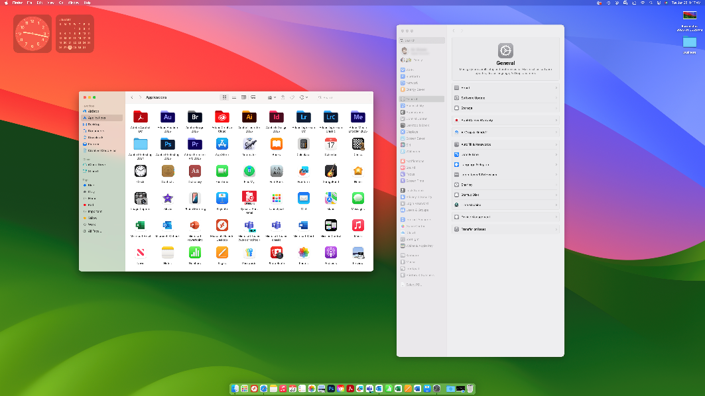
Windows and macOS (Slide 2 of 2)
Screenshot reprinted with permission from Apple Inc.
Notes:
macOS 15 Desktop

Slide 31
UNIX, Linux, and Chrome OS (Slide 1 of 2)
Unix features a shell and kernel architecture
The shell provides user interactions
The kernel manages system resources
Linux is derived from UNIX for open-source licensing
Includes a shell, desktop environment, and app packages
Standard release vs. rolling release
Chrome OS was developed by Google and based on Linux
For web applications

Slide 32
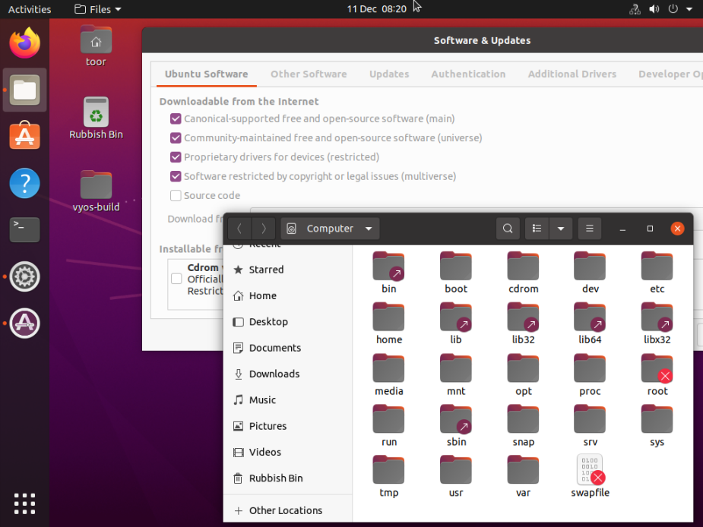
UNIX, Linux, and Chrome OS (Slide 2 of 2)
Notes:
Ubuntu Linux desktop with apps for package and file management open

Slide 33
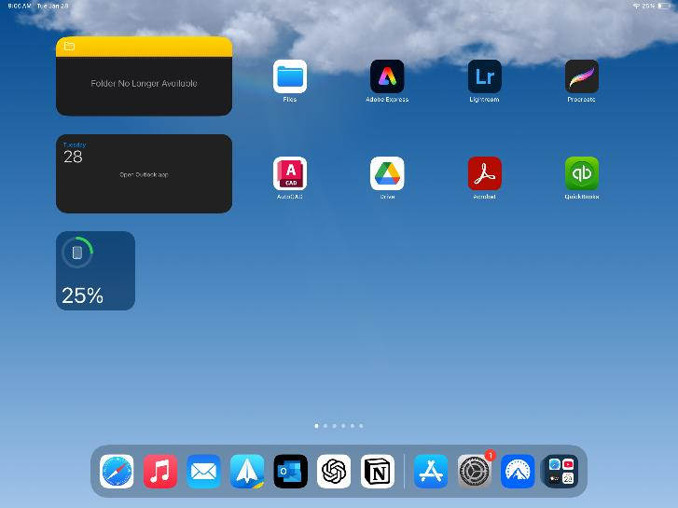
iOS and Android (Slide 1 of 2)
iOS is built to run only on Apple iPhone hardware
iPad, iWatch, tvOS
Screenshot reprinted with permission from Apple Inc.
Notes:
Learners should be aware the Apple has split the iOS family up into specific devices. While the UI is similar across the platforms, they are specific to the hardware. For example, iPadOS is only for the iPad tablet.

Slide 34
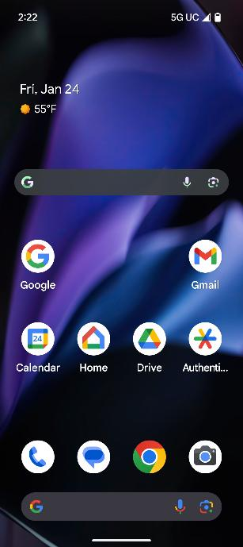
iOS and Android (Slide 2 of 2)
Android OS
open-source
OS built to run on multiple hardware platforms
Screenshot courtesy of Android platform.

Slide 35
Windows File System Types
New Technology File System (NTFS)
Developed by Microsoft
Parts
Journaling
Snapshots
Security
Indexing
Dynamic disk support
ReFS
Microsoft developed for large storage and data integrity solutions
A high-performing, scalable, and resilient file system
FAT32/exFAT
File allocation table (FAT) and extended FAT (exFAT)
Notes:
Learners should be able to specify which file systems support which operating systems. Consider showing the video Windows File Systems types on this page.

Slide 36
Linux and macOS File System Types (Slide 1 of 2)
Linux
ext4
XFS extended file system
macOS
APFS proprietary Apple File System
Notes:
Apple does support the use of ext4 and other file systems like FAT32, exFAT and HFS+. Apple can read from NTFS but cannot write to it.

Slide 37
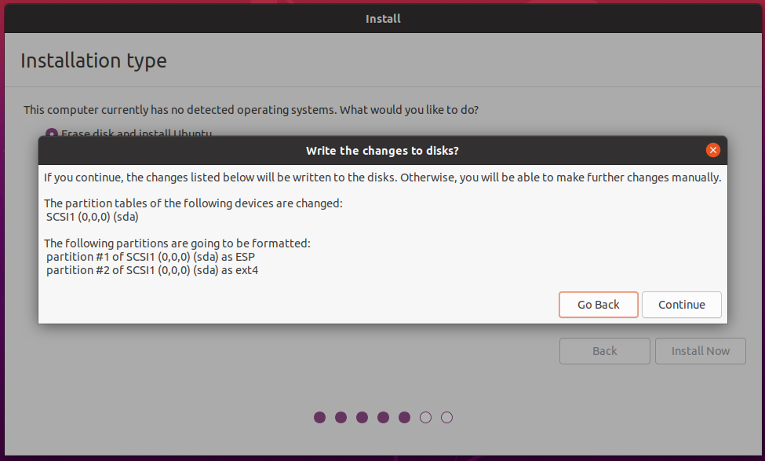
Linux and macOS File System Types (Slide 2 of 2)
Notes:
Describe the image as an Ubuntu installer applying default ext4 formatting to the target disk.

Slide 38
OS Compatibility Issues (Slide 1 of 2)
OS developed for a particular set of device hardware
Example: Windows 11 requires the support of a TPM v2.0
Software applications
Developed for a specific OS and file system
Network compatibility
Provide user training and support with changes
Notes:
Consider showing the video OS Compatibility Issues on this page.

Slide 39
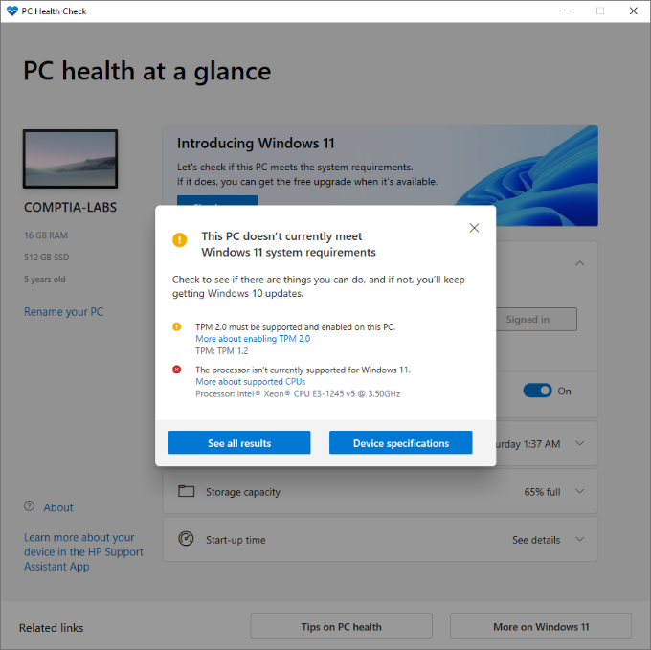
OS Compatibility Issues (Slide 2 of 2)
Screenshot courtesy of Microsoft.
Notes:
Describe the image as running a PC Health Check to verify compatibility with Windows 11.

Slide 40
Vendor Life-cycle Limitations
End-of-life/end-of-service-life
OEM or developer no longer supports product
Notes:
Remind learners that while Windows 10 is still used today it will reach its EOL/EOSL in October 2025.

Slide 41
Applied Live Lab: Manage a Support Ticket (available in CertMaster Perform and CertMaster Labs)
Challenge Live Lab: Resolve Help Desk Tickets (available in CertMaster Perform and CertMaster Labs)

Slide 42
Types of Operating Systems
Windows and macOS
UNIX, Linux, and Chrome OS
iOS and Android
Windows File System Types
Linux and macOS File System Types
OS Compatibility Issues
Vendor Life-cycle Limitations
Notes:
Take some time at the end of each topic to answer questions. You can use the Lesson Review questions for discussion in class or set them for learners to complete individually during or after class.

